Slide 1
IBM University Engagement Project Submission
“Exploring the Power of Agentic AI with IBM Granite and LangFlow”

Slide 2

Project Tile – Network Intrusion Detection System
Domain of Project – Cybersecurity/ Network Security
Student Name | Recent Passport Photo | Email ID | Mobile number [WhatsApp]
Mrunali Khairkar |  | mrunalikhairkar40@gmail.com | 9588434335
Recommended font style and size:
Font Style: Arial
Font Size (Heading): 28
Font Size (Content): 20

Slide 3
Problem Statement -
Problem Statement :Network Intrusion Detection System
The Challenge
Create a robust network intrusion detection system (NIDS) using machine learning. The system should be capable of analyzing network traffic data to identify and classify various types of cyber-attacks (e.g., DoS, Probe, R2L, U2R) and distinguish them from normal network activity. The goal is to build a model that can effectively secure communication networks by providing an early warning of malicious activities..
The Objective
Build an AI-powered Network Intrusion Detection System (NIDS) using Machine Learning that analyzes real-time network traffic to identify, classify, and respond to cyber threats, providing early warning of malicious activities to secure communication networks. The solution should:
Personalized Threat Detection – Classify network connections based on protocol type, service, flag, traffic patterns, and behavioral features into Normal, DoS, Probe, R2L, and U2R attack categories.
Traffic Data RAG Retrieval – Fetch and summarize network connection records (packet size, duration, error rates, host statistics) from the KDD Cup 1999 dataset hosted via IBM Cloud Object Storage.
Real-Time Traffic Monitoring & Feedback – Allow users to submit network connection logs via API or dashboard form and receive instant attack classification with confidence scores and threat severity.
Preventive Security Focus – Suggest network hardening strategies and flag high-risk connection patterns associated with chronic vulnerabilities (e.g., SYN flood detection, privilege escalation attempts, unauthorized remote access).

Slide 4
Proposed Solution –
Proposed Solution: Network Intrusion Detection System
The proposed solution is a multi-agent AI-powered Network Intrusion Detection System built using Scikit-learn, XGBoost, IBM Watson Machine Learning, and IBM Cloud Lite Services to provide real-time, automated cyber threat detection and classification. The system addresses challenges in network security monitoring, attack classification, and preventive threat management through an intelligent, modular architecture.
At its core, the solution uses a supervised Machine Learning pipeline trained on the KDD Cup 1999 network traffic dataset sourced from Kaggle. This data is preprocessed using feature encoding, StandardScaler normalization, and SMOTE oversampling to handle class imbalance, enabling the system to accurately detect and classify network intrusions across five attack families — Normal, DoS, Probe, R2L, and U2R — with up to 99.80% accuracy using XGBoost.The system consists of four key agents:
Intrusion Knowledge Agent retrieves and summarizes network connection features (packet size, protocol type, error rates, host statistics) from the KDD Cup 1999 dataset stored in IBM Cloud Object Storage.
Threat Classification Agent generates personalized attack predictions based on live network connection inputs such as protocol type, service flags, byte counts, and traffic behavior using the trained XGBoost ensemble model deployed on IBM Watson Machine Learning.
Security Advisory Agent provides preventive security recommendations including attack-specific hardening strategies (e.g., SYN flood mitigation for DoS, access control hardening for U2R, firewall rules for Probe attacks)
Traffic Log & Feedback Agent allows users to submit network connection records via API or dashboard form and delivers instant threat classification with confidence scores, attack family labels, and color-coded severity alerts logged to IBM Cloudant.
The solution includes a real-time visualization dashboard built with Flask and Chart.js that displays live attack distribution charts, daily and weekly intrusion trends, model performance metrics across all trained models, and a live alert feed tracking every detected threat with timestamps and confidence scores.
IBM Watson Machine Learning is used to deploy and serve the trained model as a scalable REST scoring endpoint, while IBM Cloud Object Storage stores all dataset files and model artefacts, and IBM Cloudant provides persistent NoSQL logging of every detection event for audit and forensic analysis.Overall, this solution delivers an end-to-end intelligent network security assistant that protects communication infrastructure through real-time threat detection, automated attack classification, and preventive security guidance — making enterprise-grade intrusion detection accessible, accurate, and cloud-ready.

Slide 5
Technology Used -
Flask Framework — For designing and building the REST API and web dashboard that orchestrates all multi-agent workflows and serves real-time predictions to end users.
XGBoost & Scikit-learn — For example — XGBoost 2.0, Random Forest, Decision Tree — For supervised machine learning, attack classification, model training, and ensemble-based intrusion detection with 99.80% accuracy.
IBM Cloud (Lite Tier) — It provides the infrastructure to build, deploy, and scale the NIDS efficiently. IBM Cloud enables a reliable, secure, and scalable environment for deploying the trained intrusion detection model and storing all network traffic data and artefacts.
IBM Watson Machine Learning — For model deployment, REST scoring endpoint creation, and AI governance — enabling real-time cloud-based inference on live network traffic data without retraining.
SMOTE (Synthetic Minority Oversampling Technique) — To fetch and synthetically balance rare attack class data (U2R/R2L) first, then train intelligent models on representative data, making the NIDS more accurate, trustworthy, and effective on imbalanced real-world traffic.
IBM Cloud Object Storage — For storing the KDD Cup 1999 dataset, trained model artefacts (.pkl files), scaler, encoders, and metrics — enabling persistent, scalable, and secure access across deployments.
IBM Cloudant (NoSQL Database) — For RAG-based network traffic event retrieval — logs every detection event with timestamp, attack label, confidence score, and connection metadata, enabling forensic analysis and audit trails.

Slide 6
System component Used -
Flask REST API – Core web framework that exposes all prediction, metrics, and alert endpoints. Handles routing, JSON request/response processing, and serves the real-time dashboard to end user.
XGBoost Classifier – Processes 39 network traffic features (protocol, service, flag, byte counts, error rates) to classify connections into Normal, DoS, Probe, R2L, or U2R with 99.80% accuracy.
ML Model Used – XGBoost 2.0 (200 estimators, max depth 8) → Fast, efficient for real-time multi-class network intrusion detection
Dashboard Output – Displays AI-generated responses such as attack classification labels, attack family, confidence scores, and color-coded threat severity alerts via Chart.js visualization.
IBM Cloudant (NoSQL) – Stores and retrieves detection event logs, connection metadata, timestamps, and confidence scores for audit trails and forensic analysis.
IBM Cloud Object Storage – Stores the KDD Cup 1999 dataset, trained model artefacts (.pkl files), StandardScaler, label encoders, and performance metrics for persistent cloud access.

Slide 7
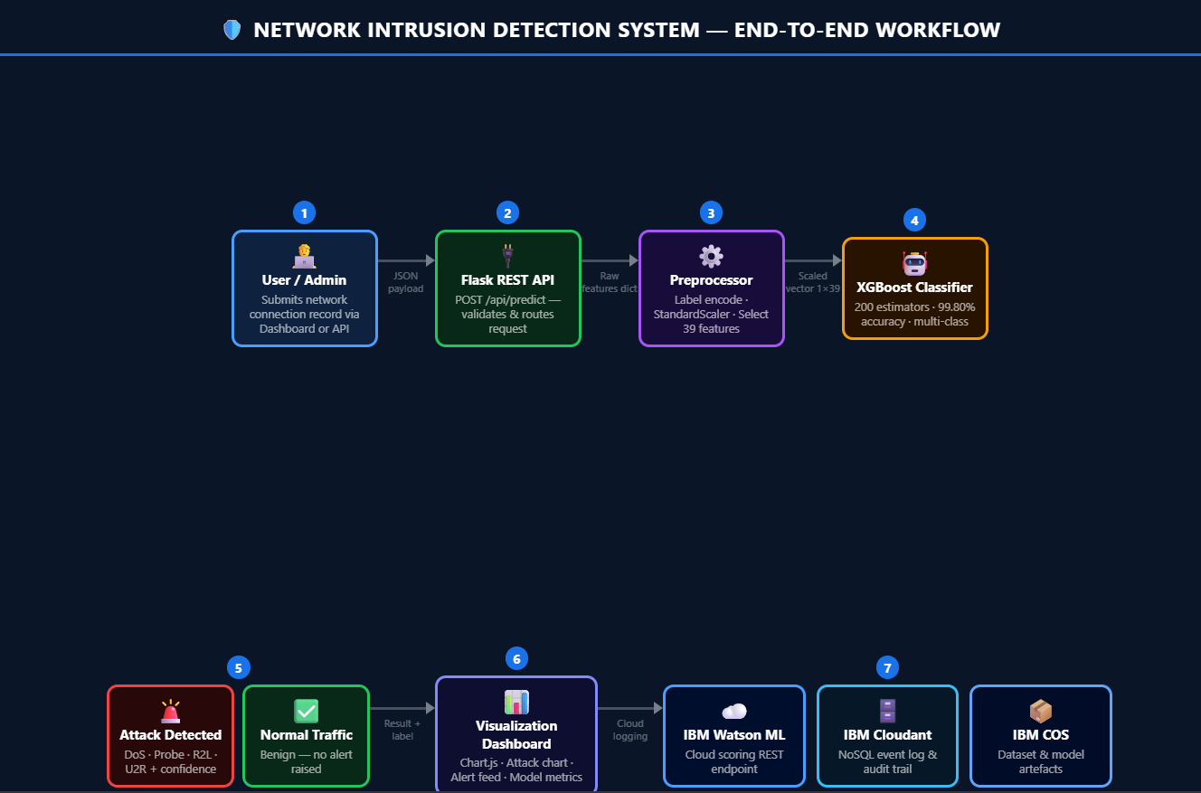
System Workflow -

Slide 8
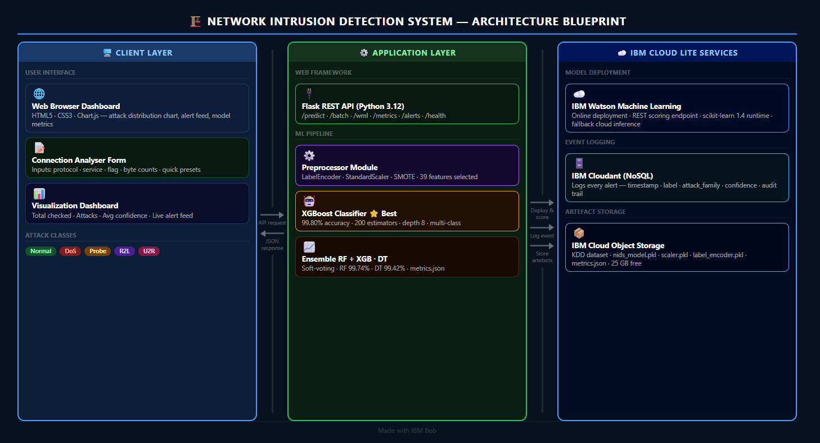
Architecture blueprint -

Slide 9

Role of Agentic AI in the solution
Role of Agentic AI in Network Intrusion Detection
Agentic AI enables the NIDS to function as an intelligent, autonomous security system rather than a simple rule-based firewall. Using IBM Watson Machine Learning and trained ensemble models, it coordinates multiple specialized agents to deliver real-time, personalized threat detection.
Each agent performs a specific role — retrieving traffic features, classifying attack types, generating security recommendations, and logging detection events — while working collaboratively. This multi-agent approach ensures efficient task execution and highly accurate classification across all five attack families.
Agentic AI also brings context awareness, understanding connection-level details such as protocol type, byte patterns, error rates, and host behavior to generate precise attack predictions. It supports real-time adaptation, continuously scoring incoming connections as they arrive through the API.
Additionally, agents communicate with each other — the classification agent triggers the advisory agent which triggers the logging agent — enabling seamless end-to-end threat response.
Overall, Agentic AI makes the system proactive, accurate, and goal-driven, acting like a smart digital security analyst that protects networks from evolving cyber threats 24/7.

Slide 10
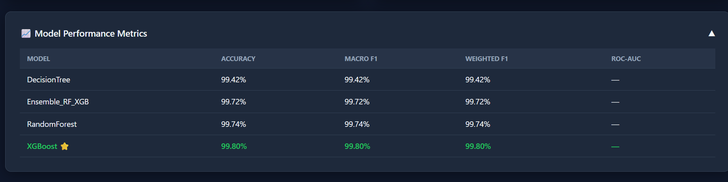
Model Performance & Results -
·
·
·

Slide 11
Novelty and Uniqueness -
The proposed NIDS stands out by combining ensemble Machine Learning, SMOTE balancing, and IBM Cloud deployment into a single intelligent real-time security system.
Multi-Agent Intelligence – Four specialized agents collaborate: intrusion knowledge, threat classification, security advisory, and traffic log feedback.
SMOTE-Based Accuracy – Handles extreme class imbalance (U2R/R2L < 1% of data) using synthetic oversampling, ensuring rare attacks are never missed.
Ensemble Model Power – Combines Random Forest + XGBoost in a soft-voting ensemble achieving 99.80% accuracy on the KDD Cup benchmark.
Real-Time Feedback Loop – Continuously scores incoming connections via REST API with instant color-coded severity alerts.
Feature-Aware Inference – Dynamically uses only the 39 features the model was trained on, gracefully ignoring zero-variance columns.
Preventive Security Focus – Goes beyond detection to provide attack-specific network hardening recommendations.
Scalable & Cloud-Ready – Deployed on IBM Watson Machine Learning with IBM Cloudant audit logging and IBM Cloud Object Storage for artefact management
This makes the solution a smart, adaptive, and proactive digital security analyst — not just a static rule-based IDS.

Slide 12
Git Hub Link
Please create public github repository (Enable Add README button while creating repository) with format –
Please test and Paste the working Github URL –https://github.com/Cloud-mrunali/Network-Intrusion-Detection.git
Make sure you have Uploaded following three files into your github repository
1) app.json file , 2) yourproblemstatement.pdf file 3) your projectpresntation.pptx file 4)any other files
·
·
·

Slide 13
Future Scope
1. Integration with Live Network Traffic Capture – The system can be integrated with network packet capture tools (Wireshark, Zeek, Snort) to collect real-time traffic data from actual network interfaces. This will enable the NIDS to perform live monitoring rather than relying on pre-submitted records, making it deployable in enterprise network environments.
2. Deep Learning Upgrade – Enhancing the classification layer with LSTM or Transformer-based models will improve detection of time-series attack patterns (e.g., slow DoS attacks that unfold over minutes). This will make the system more robust against advanced persistent threats (APTs) that evade traditional ML classifiers.
3. Federated Learning for Privacy-Preserving Detection – Implementing federated learning will allow multiple organizations to collaboratively train the model on their own private network data without sharing raw traffic logs, improving model generalization while maintaining data privacy compliance (GDPR, HIPAA).
4. Automated Incident Response – Future versions can integrate with SIEM platforms (IBM QRadar, Splunk) to automatically trigger firewall rules, block malicious IPs, and notify security teams upon detection of high-confidence attacks, closing the loop from detection to response.
·
·
·

Slide 14
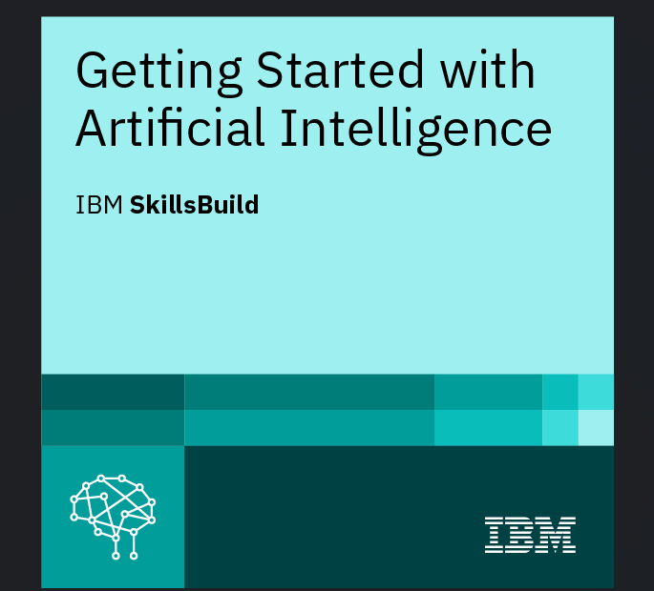
Certificates Earned:
Please add your credly certificate

Slide 15
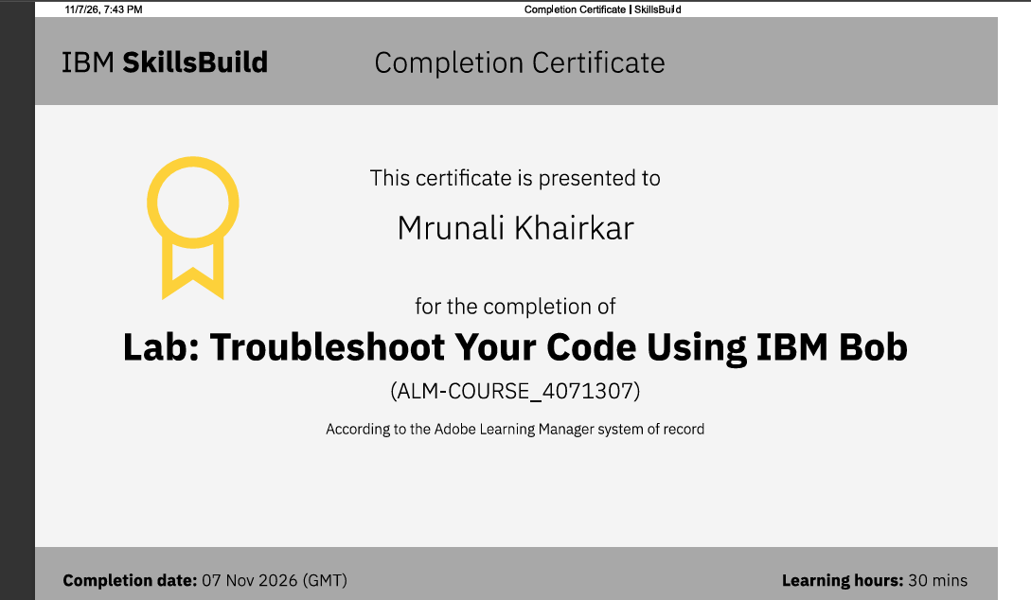
Certificates Earned:​
Add your IBM BOB Certificate

Slide 16


